Slide 1
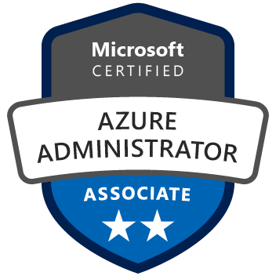

Exam AZ-103: Microsoft Azure Administrator Crash Course
Tim Warner
@TechTrainerTim

Slide 2
Day 1 of 2 Agenda
Introduction
Module 1: Manage Azure Subscriptions and Resources
Module 2 Implement and Manage Storage
Module 3: Deploy and Manage Virtual Machines
Synthesis and look ahead to Day 2

Slide 3
Day 2 of 2 Agenda
Quick content review
Module 4: Configure and Manage Virtual Networks
Module 5: Manage Identities
Module 6: Exam AZ-100 Exam Strategy

Slide 4
Course Materials (Important!)
http://timw.info/admincrashcourse

Slide 5
Microsoft Role-Based Certifications

Slide 6
Tim's Cert Study Pyramid
Interdependence
Content knowledge
Practical application
Test-taking skills

Slide 7
Module 1: Manage Azure Subscriptions and Resources

Slide 8
Module 1 Learning Objectives
Manage Azure subscriptions
Analyze resource utilization and consumption
Manage resource groups
Manage Role Based Access Control (RBAC)

Slide 9
Manage Azure Subscriptions
Assign administrator permissions
Configure cost center quotas and tagging
Configure Azure subscription policies at the Azure subscription level

Slide 10
Analyze Resource Utilization
Configure diagnostic settings on resources
Create a baseline for resources
Create and handle alerts
Analyze alerts across subscriptions
Analyze metrics across subscriptions

Slide 11
Analyze Resource Utilization, Cont’d
Create action groups
Monitor for unused resources
Monitor spend
Report on spend
Utilize Log Search query functions
View alerts in Log Analytics

Slide 12
Manage Resource Groups
Use Azure policies for resource groups
Configure resource locks
Configure resource policies
Identify auditing requirements
Implement and set tagging on resource groups
Move resources across resource groups
Remove resource groups

Slide 13
Manage Role-Based Access Control
Create a custom role
Configure access to Azure resources by assigning roles
Configure management access to Azure, troubleshoot RBAC, implement RBAC policies, assign RBAC Roles

Slide 14
Module 1 Demo
Make user Contributor at the subscription scope
Log into Azure portal as the new Contributor
Create a deployment:
Resource group
Storage account
Grant another user read access to the resource group
Verify by attempting to delete the storage account

Slide 15
Module 1 Summary

Slide 16
Module 2: Implement and Manage Storage

Slide 17
Module 2 Learning Objectives
Create and configure storage accounts
Import and export data to Azure
Configure Azure Files
Implement Azure backup

Slide 18
Create Storage Accounts
Create and configure a storage account
Configure network access to the storage account
Generate a shared access signature
Install and use Azure Storage Explorer
Manage access keys
Monitor activity log by using Log Analytics
Implement Azure storage replication

Slide 19
Import and Export Data to Azure
Create an export from Azure job
Create an import into Azure job
Use Azure Data Box
Configure and use Azure blob storage
Configure Azure content delivery network (CDN) endpoints

Slide 20
Configure Azure Files
Create Azure file share
Create Azure File Sync service
Create Azure sync group
Troubleshoot Azure File Sync

Slide 21
Implement Azure Backup
Configure and review backup reports
Perform backup operation
Create a Recovery Services Vault
Create and configure backup policy
Perform a restore operation

Slide 22
Module 2 Summary

Slide 23
Module 2 Demo
Connect to storage account from Storage Explorer
Upload/download files
Create and used a shared access signature
Connect Azure Cloud Shell
Create cloud shell
View file share in shell and in Azure portal
Configure VM backup
Create Recovery Services vault

Slide 24
Module 3: Deploy and Manage Virtual Machines

Slide 25
Module 3 Learning Objectives
Create and configure a VM for Windows and Linux
Automate VM deployment
Manage Azure VM configuration
Manage Azure VM backups

Slide 26
Create and Configure a VM
Configure high availability
Configure monitoring, networking, storage, and virtual machine size
Deploy and configure scale sets

Slide 27
Automate VM Deployment
Modify a Azure Resource Manager (ARM) template
Configure the location of new VMs
Configure a VHD template
Deploy from a template
Save a deployment as an ARM template
Deploy Windows and Linux VMs programmatically

Slide 28
Manage Azure VM Configuration
Add data disks
Add network interfaces
Automate configuration management by using PowerShell Desired State Configuration (DSC) and VM Agent by using custom script extensions
Manage VM sizes; move VMs from one resource group to another
Redeploy VMs

Slide 29
Manage Azure VM Backup
Configure VM backup
Define backup policies
Implement backup policies
Perform VM restore
Azure Site Recovery

Slide 30
Module 3 Demo
Create a Linux VM with SSH authentication via Azure portal
Place on one VNet
Create a Windows VM from an ARM template
Place on a second VNet
Practice restores from previously backed-up VM
Full restore
File Recovery

Slide 31
Module 3 Summary

Slide 32
Module 4: Configure and Manage Virtual Networks

Slide 33
Module 4 Learning Objectives
Create connectivity between virtual networks
Implement and manage virtual networking
Configure name resolution
Create and configure a Network Security Group (NSG)

Slide 34
Module 4 Learning Objectives (Cont’d)
Implement Azure load balancer
Monitor and troubleshoot virtual networking
Integrate on-premises network with Azure virtual network

Slide 35
Implement Virtual Networks
Configure private and public IP addresses, network routes, network interface, subnets, and virtual network

Slide 36
Define VNet Connectivity
Create and configure VNET peering
Create and configure VNET to VNET
Verify virtual network connectivity
Create virtual network gateway

Slide 37
Configure Name Resolution
Configure Azure DNS
Configure custom DNS settings
Configure private and public DNS zones

Slide 38
Create and Configure NSGs
Create security rules
Associate NSG to a subnet or network interface
Identify required ports
Evaluate effective security rules

Slide 39
Implement Azure Load Balancer
Configure internal load balancer, configure load balancing rules, configure public load balancer, troubleshoot load balancing

Slide 40
Monitor and Troubleshoot Networking
monitor on-premises connectivity, use Network resource monitoring, use Network Watcher, troubleshoot external networking, troubleshoot virtual network connectivity

Slide 41
Create a Hybrid Cloud Network
Create and configure Azure VPN Gateway, create and configure site to site VPN, configure Express Route, verify on premises connectivity, troubleshoot on premises connectivity with Azure

Slide 42
Module 4 Demo
Add a custom DNS server address
Create a VNet peering between the two Vnets
Use Network Watcher to test connectivity
Pay particular attention to NSGs
Walk through S2S VPN configuration at a high level

Slide 43
Module 4 Summary

Slide 44
Module 5: Manage Identities

Slide 45
Module 5 Learning Objectives
Manage Azure Active Directory
Manage Azure AD objects (users, groups, devices)
Implement and manage hybrid identities
Implement multi-factor authentication (MFA)

Slide 46
Manage Azure Active Directory
Add custom domains
Azure AD Join
Configure self-service password reset
Manage multiple directories

Slide 47
Manage Azure AD Objects
Create users and groups
Manage user and group properties
Manage device settings
Perform bulk user updates
Manage guest accounts

Slide 48
Implement Hybrid Identities
Install Azure AD Connect, including password hash and pass-through synchronization
Use Azure AD Connect to configure federation with on-premises Active Directory Domain Services (AD DS)
Manage Azure AD Connect
Manage password sync and password writeback

Slide 49
Implement MFA
Configure user accounts for MFA, enable MFA by using bulk update, configure fraud alerts, configure bypass options, configure Trusted IPs, configure verification methods

Slide 50
Module 5 Demo
Create an MFA Users group
Create MFA conditional access policy
Based on Azure AD group membership
Create an Azure AD user
Grant RBAC at resource group level
Test access
MFA registration
Resource access

Slide 51
Module 5 Summary

Slide 52
Module 6: Exam AZ-103 Study Strategy

Slide 53
Module 6 Learning Objectives
Master the concepts
Master the hands-on skills
Master test-taking skills
Know what to expect before, during, and after the exam

Slide 54
Master the Concepts

Slide 55
Master the Hands-On Skills

Slide 56
Master the Test-Taking Skills

Slide 57
Understand the Certification Workflow

Slide 58
Module 6 Demo
Tour relevant websites:
Exam page(s) with registration workflow
Mindhub offers
MeasureUp.com
Work through practice items
Show MCP dashboard

Slide 59
Module 6 Summary

Slide 60
Exam AZ-103 Item Types

Slide 61

Single-Answer Multiple Choice

Slide 62
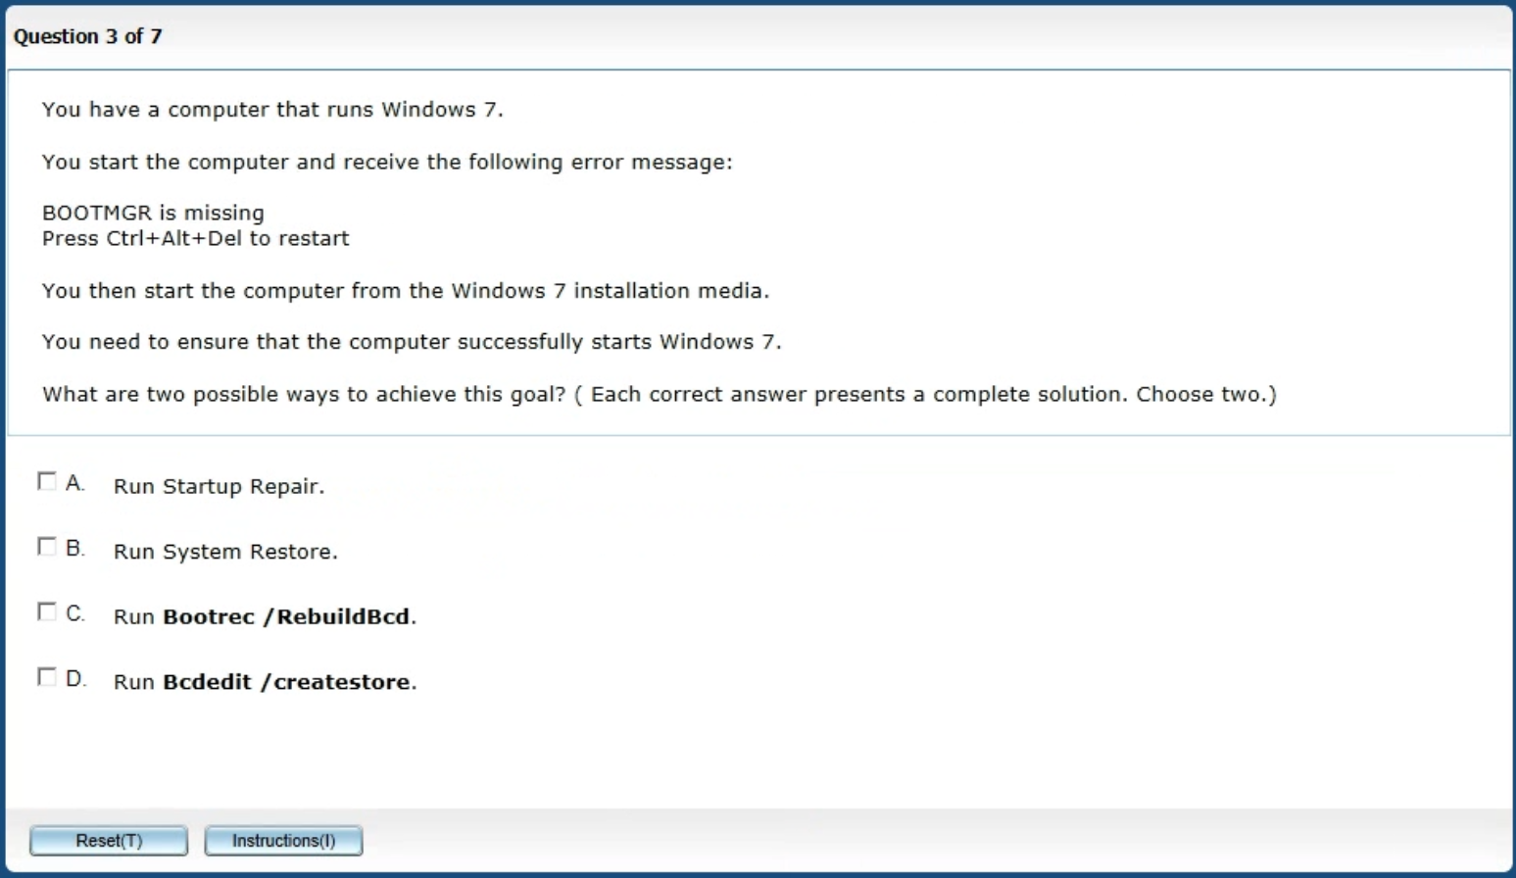
Multiple-Answer Multiple Choice

Slide 63
Repeated Scenario
You need to move an Azure VM to another hardware host.
Solution: You redeploy the VM.
Does this solution meet the goal?
Yes
No

Slide 64

Select and Place

Slide 65

Build List and Reorder

Slide 66
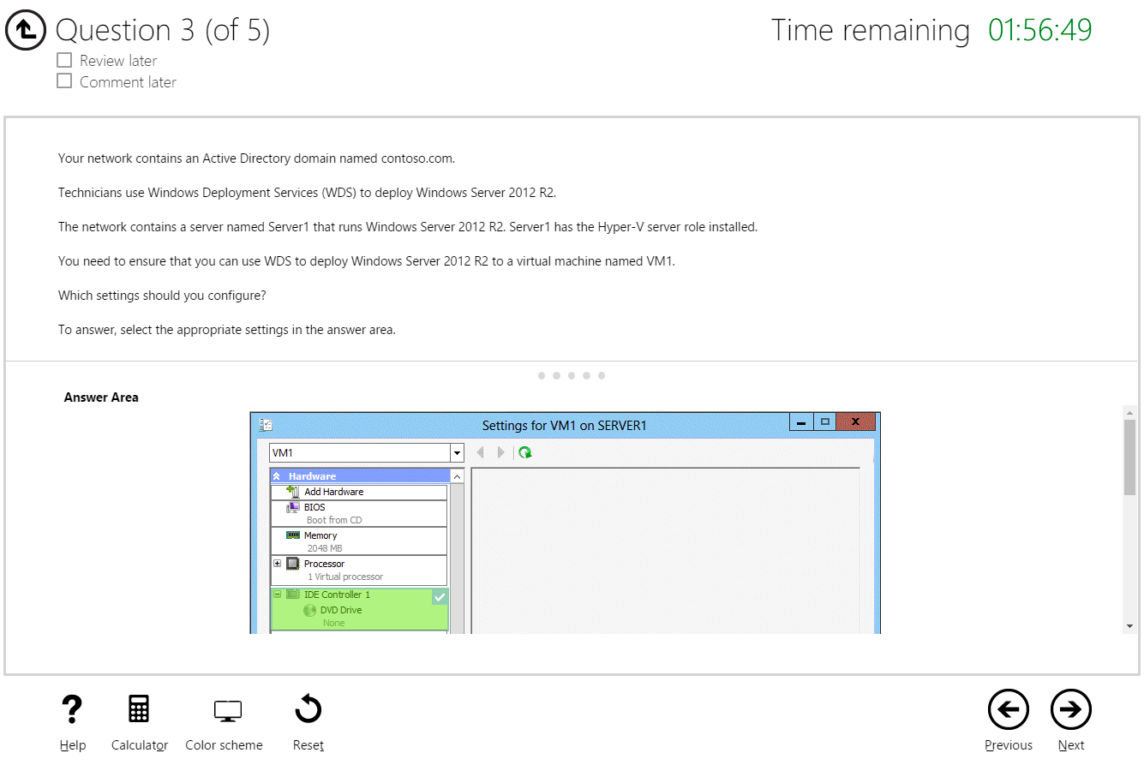
Hot Area

Slide 67

Active Screen

Slide 68

Case Study

Slide 69
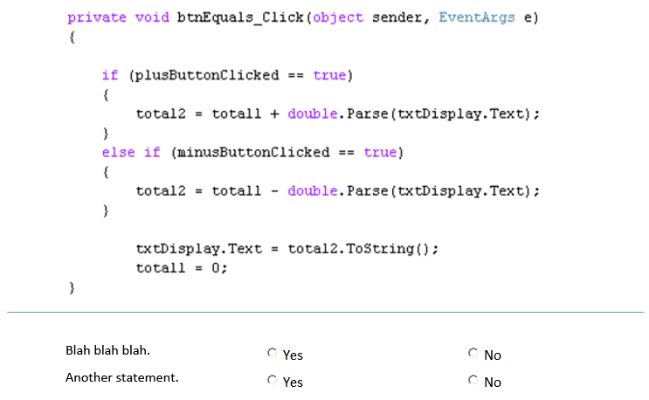
Statement / Code Analysis

Slide 70
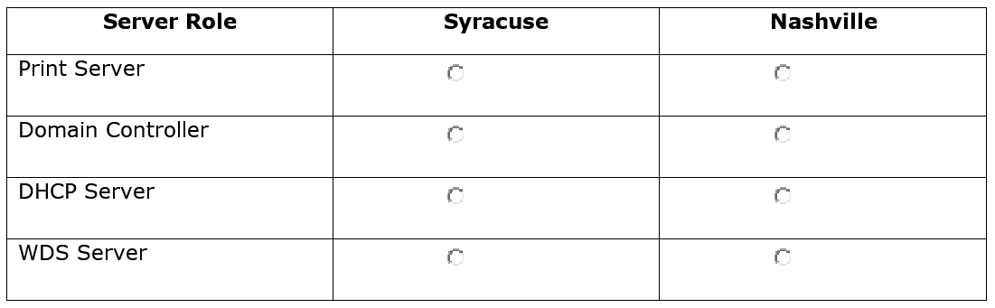
Two-Part Analysis

Slide 71
Statement Completion

Slide 72

Performance-Based Lab

